Slide 1
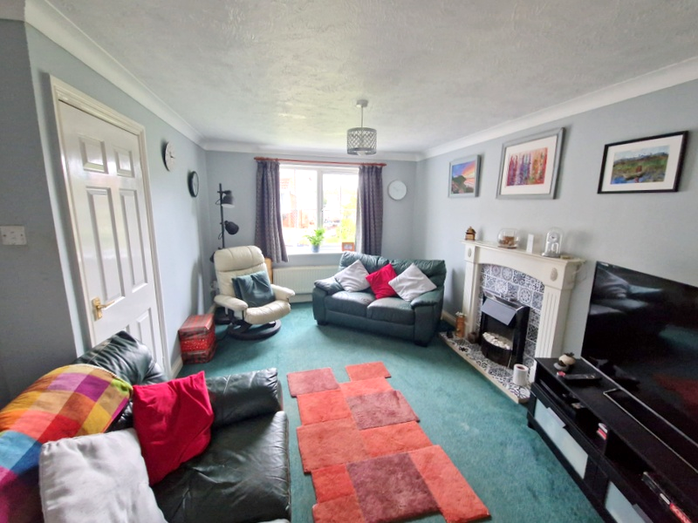
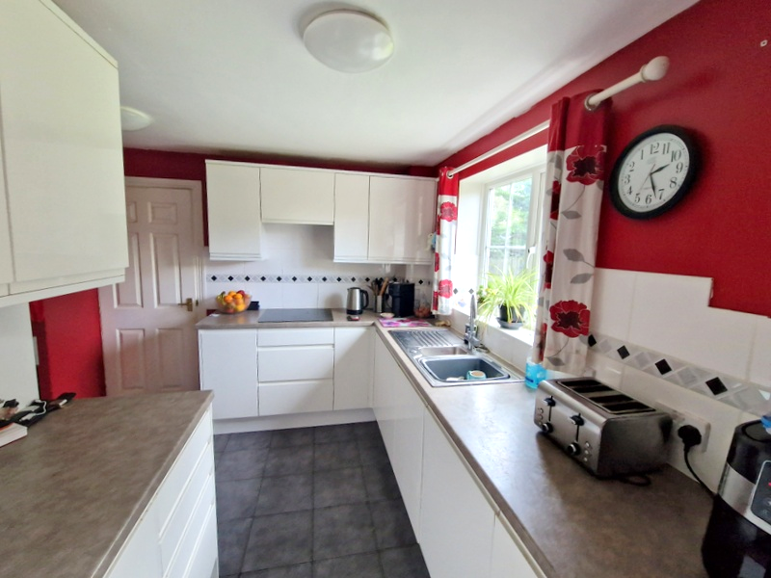
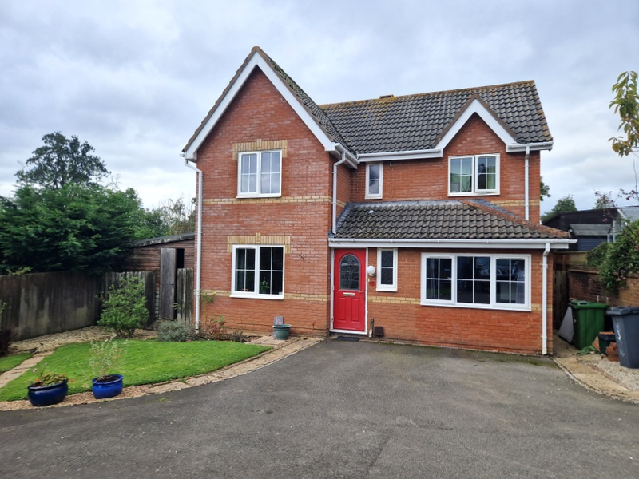
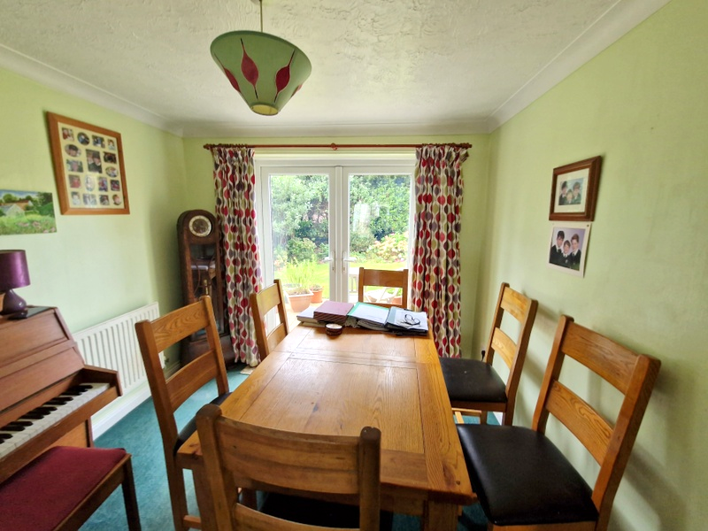
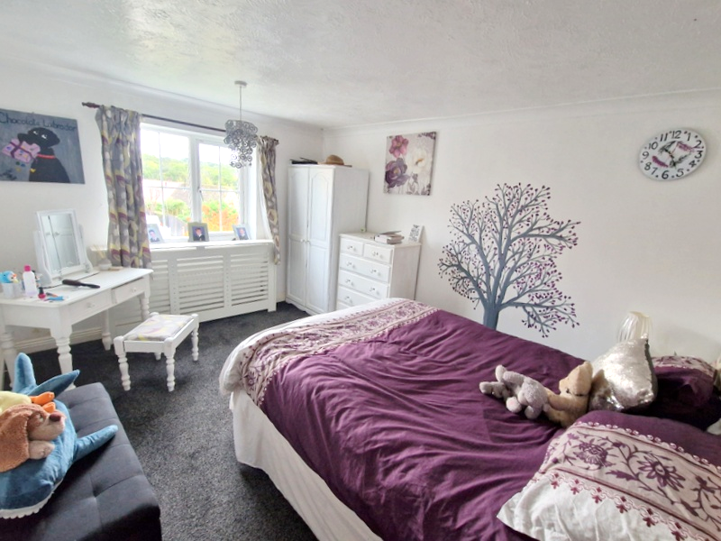
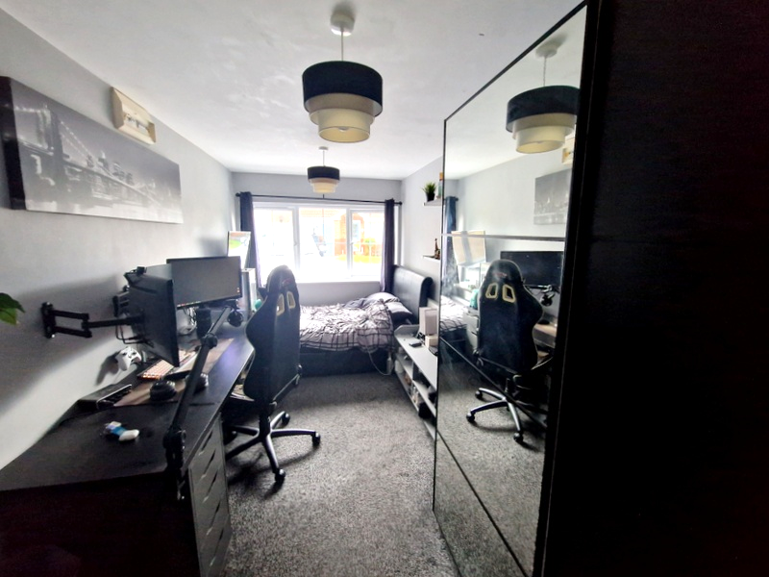
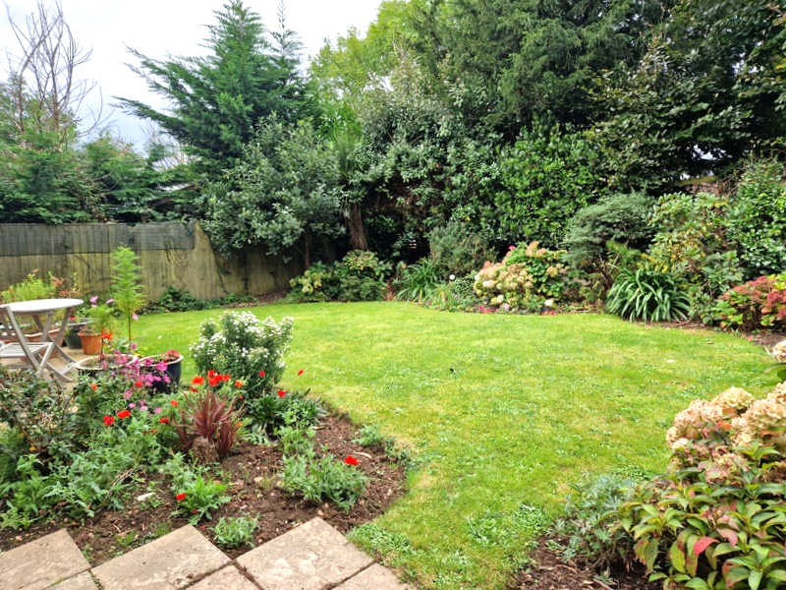
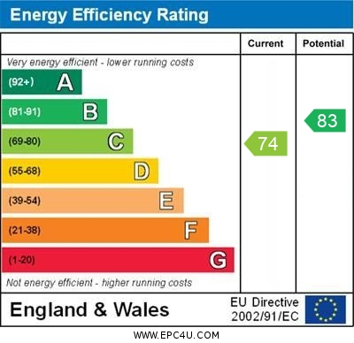
www.pennys.net
3 Cheriswood Close, Exmouth, EX8 4DZ
GUIDE PRICE £480,000
TENURE Freehold
A Detached Four/Five Bedroom House Quietly Situated In A Favoured Area Close To Amenities With Attractive Gardens And Double Width Drive
Ground Floor Cloakroom/Wc * Lounge * Dining Room * Refitted Kitchen * Utility Room Ground Floor Bedroom/Family Room * Four First Floor Bedrooms – En-Suite Shower Room/Wc * Family Bathroom Suite * Gas Central Heating * Double Glazed Windows Super Family Home
Pennys Estate Agents Limited for themselves and for the vendor of this property whose agents they are give notice that:- (1) These particulars do not constitute any part of an offer or a contract. (2) All statements contained in these particulars are made without responsibility on the part of Pennys Estate Agents Limited. (3) None of the statements contained in these particulars are to be relied upon as a statement or representation of fact. (4) Any intending purchaser must satisfy himself/herself by inspection or otherwise as to the correctness of each of the statements contained in these particulars. (5) The vendor does not make or give and neither do Pennys Estate Agents Limited nor any person in their employment has any authority to make or give any representation or warranty whatever in relation to this property.
PENNYS ESTATE AGENTS
2 Rolle House, Rolle Street, Exmouth, Devon, EX8 2SN
Tel: 01395 264111 EMail: help@pennys.net

Slide 2
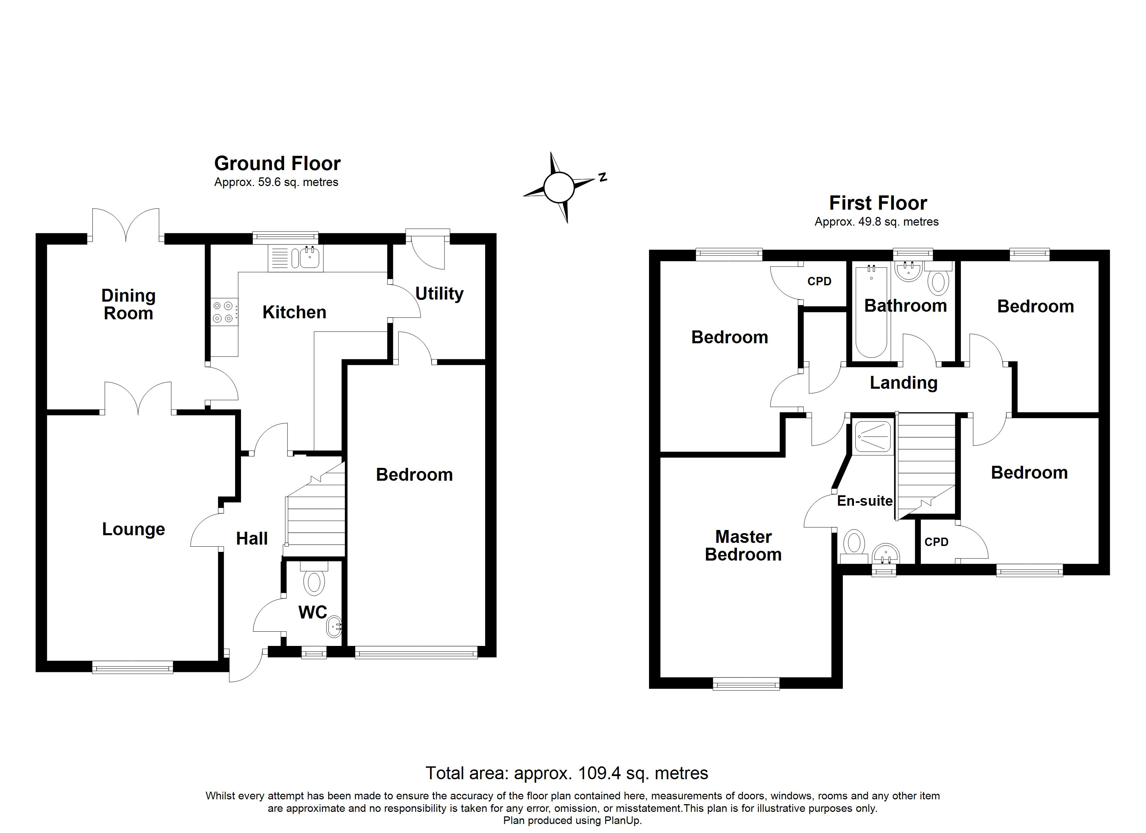
3 Cheriswood Close, Exmouth, EX8 4DZ
THE ACCOMMODATION COMPRISES: Front door with patterned glass window inset giving access to:
RECEPTION HALL: Radiator, stairs rising to first floor landing with useful understairs storage cupboard beneath.
CLOAKROOM/WC: Wash hand basin with tiled splashback, WC, radiator, double glazed window with patterned glass.
LOUNGE: 4.44m x 3.1m (14'7" x 10'2") A double glazed window to front aspect, fire surround housing electric pebble-effect living flame fire, TV point, radiator, double glazed panelled doors to:
DINING ROOM: 2.95m x 2.84m (9'8" x 9'4") Double glazed doors opening onto the rear garden, radiator.
KITCHEN: 3.15m x 3.58m (10'4" x 11'9") maximum. (Access from both the dining room and reception hall). Refitted with a range of stylish white units under colour coordinated working surfaces with inset induction hob with extractor hood over, cupboards, drawer units and integrated dishwasher beneath the work surfaces. Inset single drainer sink unit with mixer tap, range of wall mounted cupboards, tiled surrounds, built-in oven with space for microwave over and cupboards above and below, tiled flooring and double glazed window overlooking the rear garden.
UTILITY ROOM: 2.18m x 1.68m (7'2" x 5'6") With plumbing for automatic washing machine and space for tumble dryer, space for large American style fridge/freezer, tiled flooring, fitted cupboards, radiator, double glazed door giving access to rear garden and door to:
BEDROOM 5/FAMILY ROOM: 4.88m x 2.31m (16'0" x 7'7") A versatile room, double glazed window overlooking the front aspect, radiator, electric consumer unit.
FIRST FLOOR LANDING: With large loft hatch giving access to roof space, cupboard housing Worcester gas boiler for hot water and central heating.
BEDROOM 1: 4.67m x 3.12m (15'4" x 10'3") With double glazed window to front aspect, radiator housed in radiator cover.
EN-SUITE SHOWER ROOM/WC: 2.64m x 1.65m (8'8" x 5'5") maximum measurement. Comprising shower cubicle with splash screen door, pedestal wash hand basin, WC with push button flush, chrome heated towel rail, shaver socket, extractor fan and double glazed window with patterned glass.
BEDROOM 2: 3.43m x 2.49m (11'3" x 8'2") With double glazed window to rear aspect, radiator, built-in wardrobe.
BEDROOM 3: 2.72m x 2.44m (8'11" x 8'0") Double glazed window to front aspect, built-in cupboard over stairwell recess, TV point, radiator.
BEDROOM 4: 2.69m x 2.39m (8'10" x 7'10") With double glazed window to rear aspect, radiator.
FAMILY BATHROOM/WC: Comprising bath with shower attachment, shower curtain and rail, pedestal wash hand basin, WC with push button flush, chrome heated towel rail, extractor fan, double glazed window with patterned glass.
OUTSIDE: Quietly situated in a select private drive off Cheriswood Avenue, the property is approached by a double width driveway with attractive lawned front gardens with colourful flower and shrub beds. The property also owns a decorative stone flower bed alongside the private drive. Accessed from the front garden is a TIMBER GARDEN STORE 3.1m x 2.44m (10'2" x 8'0") with further door giving access through to the rear garden. The rear garden is a lovely feature of the property enjoying a high degree of privacy and seclusion, laid to lawn with colourful well stocked flower and shrub beds, patio sun terrace areas ideal for outside entertaining, outside cold water tap, side pathway and gate gives access back round to the front of the property.
Mortgage Assistance: We are pleased to recommend Meredith Morgan Taylor, who would be pleased to help no matter which estate agent you finally buy through. For a free initial chat please contact us on to arrange an appointment. Your home may be repossessed if you do not keep up repayments on your mortgage. Meredith Morgan Taylor Ltd is an appointed representative of The Openwork Partnership, a trading style of Openwork Ltd which is authorised and regulated by the Financial Conduct Authority (FCA).
FLOOR PLAN:

